Slide 1
Chapter 17
Nonparametric Tests
Chi-Square Tests

Slide 2
Chapter Outline
Tests for Nominal Data
The Chi-Square Goodness-of-Fit Test
Interpreting the Chi-Square Goodness-of-Fit Test
Independent Observations and Expected Frequency Size
The Chi-Square Test for Independence
The Relationship Between Chi-Square and Phi Coefficient
Measures of Effect Size
APA in Focus: Reporting the Chi-Square Test

Slide 3
Tests for Nominal Data
Previous chapters dealt only with interval or ratio scale data
These were parametric tests, which are used to test hypotheses about parameters in a population
Nominal and ordinal scale data do not meaningfully convey distance in which scores deviate from the mean. Thus a different method of testing is utilized.
Nonparametric tests – hypothesis tests that are used (1) to test hypotheses that do not make inferences about parameters in a population, (2) to test hypotheses about data that can have any type of distribution, and (3) to analyze data on a nominal or ordinal scale of measurement
Chi-square ( ) test – statistical procedure used to test hypotheses about the discrepancy between the observed and expected frequencies in two or more nominal categories

Slide 4
The Chi-Square Goodness-of-Fit Test
Chi-square ( ) goodness-of-fit test – statistical procedure used to test hypotheses about the discrepancy between the observed and expected frequencies for the levels of a single categorical variable or two categorical variables observed together.
Indicates how well a set of observed frequencies fits with what was expected

Slide 5
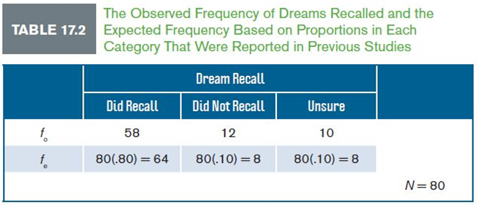
Example 17.1: The Chi-Square Goodness-of-Fit Test
Researchers interested in dream recall recruit 80 participants to sleep overnight in a laboratory. Participants were woken during REM sleep and asked if they were dreaming or not. Dream recall was measured (did, did not, unsure).
On the basis of previous research, it was expected that 80% of participants would recall, 10% would not and 10% would be unsure
Compute a chi-square goodness-of-fit test at .05 level of significance

Slide 6
Example 17.1: The Chi-Square Goodness-of-Fit Test (cont.)
Table 17.2 displays two rows of frequencies
The top row lists the frequency observed ( )
Frequency observed ( ) – is the count or frequency of participants recorded in each category or each level of the categorical variable
The bottom row lists the frequency expected ( )
Frequency expected ( ) – is the count or frequency of participants in each category, or at each level of the categorical variable, as determined by the proportion expected in each category
This value is computed based on the proportions expected in each category
In this example, 80 were observed of whom we expected 80% to recall, 10% not to recall, and 10% to be unsure
Multiply total sample size (N) times proportion expected in each category (p) to find the frequency expected in each category

Slide 7
Example 17.1: The Chi-Square Goodness-of-Fit Test (cont.)
The Test Statistic
The null hypothesis for the chi-square goodness-of-fit test is that the expected frequencies are correct
The alternative hypothesis is that the expected frequencies are not correct
The larger the discrepancy between the observed and expected frequencies, the more likely we are to reject the null hypothesis
The test statistic is:

Slide 8
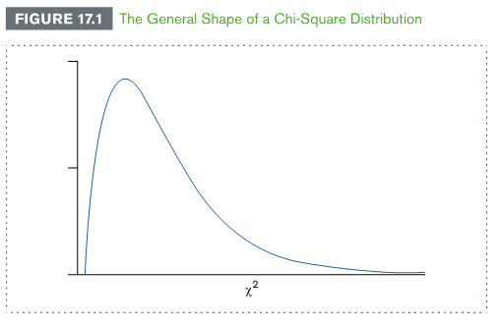
Example 17.1: The Chi-Square Goodness-of-Fit Test (cont.)
Degrees of Freedom
To make a decision, compare the test statistic obtained to the distribution of chi-square test statistic values in the positively skewed chi-square distribution
Chi-square distribution – positively skewed distribution of chi-square test statistic values for all possible samples when the null hypothesis is true
The df for each chi-square distribution are equal to the number of levels of the categorical variable (k) minus 1:

Slide 9
Example 17.1: Hypothesis Testing for Goodness of Fit (cont.)
Step 1: State the hypotheses
H₀: The distribution of proportions (8:1:1) is the same as expected
H₁ :Not H₀ : The distribution of proportions differs from that stated by the null hypothesis
Step 2: Set the criteria
Level of significance is .05
df are
Critical value is found in Table B7 in Appendix B
Critical value is 5.99
Because the chi-square distribution is positively skewed, the rejection region is always placed in the upper tail
Notes:
**Need updated Figure 17.2 (pg. 574)

Slide 10
Example 17.1: Hypothesis Testing for Goodness of Fit (cont.)
Step 3: Compute the test statistic
Substitute the observed and expected frequencies into the test statistic formula one column at a time:
Step 4: Make a decision
Compare the value of the test statistic with the critical value
In this example, 3.06 fails to exceed the critical value of 5.99
We retain the null hypothesis
dream recall during REM sleep was similar to what was expected

Slide 11
Interpreting the Chi-Square Goodness-of-Fit Test
Interpreting the chi-square goodness-of-fit test is different than any other test taught in this book in two ways
The chi-square test:
is not interpreted in terms of differences between categories
can be used to confirm that a null hypothesis is correct

Slide 12
Interpreting a Significant Chi-Square Goodness-of-Fit Test
We compare the discrepancy between observed and expected frequencies at each level of the categorical variable, thereby making a total of k comparisons
Do not compare across levels of the categorical variable
Because the test statistic does not compare differences between the discrepancies, there is no statistical basis for identifying which discrepancies are actually significant
When a chi-square goodness-of-fit test is significant, we mostly speculate as to which observed frequencies were significantly different from the expected frequencies

Slide 13
Using the Chi-Square Goodness-of-Fit Test to Support the Null Hypothesis
The chi-square goodness-of-fit test is one of the few hypothesis tests used to confirm that a null hypothesis is correct
In previous example, we found that the proportion of participants recalling dreams was consistent with what we would expect
This was the result we were looking for – we had no reason to think this wouldn’t be the case, based on the expected frequencies
Decision to retain the null is the goal of the chi-square goodness-of-fit test
It is a rare example of a test used for this purpose

Slide 14
Independent Observations and Expected Frequency Size
A key assumption for the chi-square goodness-of-fit test is that the observed frequencies are recorded independently
Each observed frequency must come from different and unrelated participants
One restriction using this test is that the size of an expected frequency should never be smaller than 5 in a given category
There are two ways to overcome this limitation:
1. Increase the sample size so that it is five times larger than the number of levels of the categorical variable
2. Increase the number of levels of the categorical variable.

Slide 15
The Chi-Square Test for Independence
Chi-square test for independence – statistical procedure used to determine whether frequencies observed at the combination of levels of two categorical variables are similar to frequencies expected
Attempting to determine the extent to which two variables are related
Two categorical variables with any number of levels
The chi-square test for independence is interpreted similar to a correlation
If two categorical variables are independent, they are not related or correlated
If two categorical variables are dependent, they are related or correlated

Slide 16
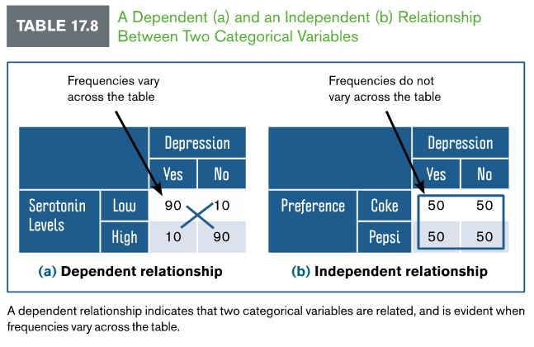
The Chi-Square Test for Independence (cont.)

Slide 17
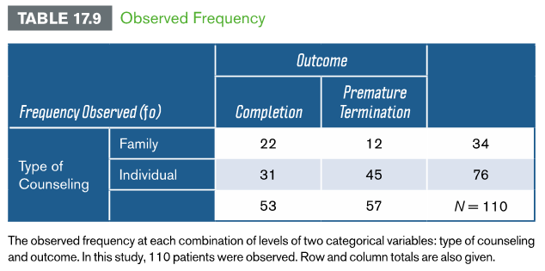
Example 17.2: The Chi-Square Test for Independence
Previous studies show that patients often discontinue scheduled counseling prematurely. Suppose that we hypothesize that more patients will complete counseling when the family is involved with the counseling. To test this hypothesis, we measure the relationship between the type of counseling (family vs. individual) and the counseling outcome (completion vs. premature termination). Table 17.9 shows the results of this study. Compute a chi-square test for independence using a .05 level of significance.

Slide 18
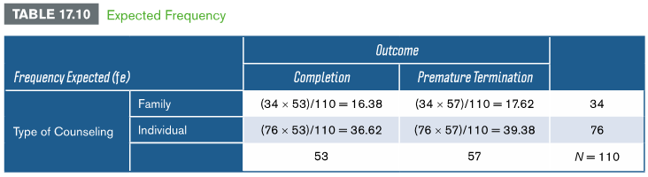
Example 17.2: The Chi-Square Test for Independence (cont.)
Determining Expected Frequencies
1. Identify the row and column totals for each cell. These totals represent the sample size for each cell
2. Compute the following formula for each cell:

Slide 19
Example 17.2: The Chi-Square Test for Independence (cont.)
The Test Statistic
The test statistic for the chi-square goodness-of-fit test and chi-square test for independence are the same:
The Degrees of Freedom
Each categorical variable is associated with k – 1 df
It is found by multiplying the df for each factor:
As with the chi-square goodness-of-fit test, the df reflect the number of cells or categories that are free to vary in a frequency table

Slide 20
Example 17.2: Hypothesis Testing for Independence
Step 1: State the hypothesis
H₀ The type of counseling and outcome of counseling are independent or not related. The observed frequencies will be equal to the expected
H₁ The type of counseling and outcome of counseling are dependent or related. The observed frequencies will not be equal to the expected frequencies in each cell
Step 2: Set the criteria
Level of significance is .05
df = 1
The critical value is 3.84

Slide 21
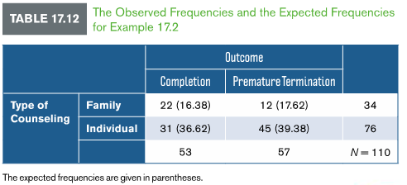
Example 17.2: Hypothesis Testing for Independence (cont.)
Step 3: Compute the Test Statistic
Using the values in the table, sum the discrepancy between observed and expected frequencies one cell at a time:
Step 4: Make a decision
Compare the value of the test
statistic to the critical value
Because 5.386 exceeds the
critical value of 3.84, reject the null hypothesis

Slide 22
The Relationship Between Chi-Square and Phi Coefficient
The phi correlation coefficient can be used in place of a 2 x 2 chi-square test for independence
The conversion equation and the computation of the chi-square test statistic produce the same value of
The phi correlation coefficient and the chi-square test statistic are related in that we can use the value of one to compute the other
The relationship between these statistics also allows us to use the phi coefficient to estimate effect size with the chi-square test for independence

Slide 23
Measures of Effect Size
There are three common measures of effect size for the chi-square test for independence
Proportion of variance
Phi coefficient
Cramer’s V
Proportion of variance
When stated as an effect size with a chi-square test for independence, the r term is replaced with
In Example 17.2, we selected 110 participants and computed
The proportion of variance is:
Type of counseling attended accounts for 5% of total variance for completing counseling

Slide 24
Measures of Effect Size (cont.)
Phi coefficient
The square root of the proportion of variance is the phi coefficient
Using the phi coefficient to estimate effect size in Example 17.2, we take the square root of the proportion of variance:
Cramer’s V
When the levels of one or more categorical variables are greater than two, we use Cramer’s V or Cramer’s phi to estimate effect size
df-smaller is the smaller of the two df

Slide 25
Chi-Square Test in R
#chisq.test performs chi-squared contingency table tests and goodness-of-fit tests.
#https://www.rdocumentation.org/packages/stats/versions/3.4.3/topics/chisq.test
M <- as.table(rbind(c(22, 31), c(12, 45)))
dimnames(M) <- list(outcome = c("Completion", "Premature Termination"), TypeOfCounselling = c("Family","Individual"))
(Xsq <- chisq.test(M))

Slide 26
Chi-Square Test in SPSS
Hypothetical Example: Effectiveness of a Drug Treatment
Let’s consider a hypothetical case where we test the effectiveness of a drug for a certain medical condition. Suppose we have 105 patients under study and 50 of them were treated with the drug. The remaining 55 patients were kept as control samples. The health condition of all patients was checked after a week.

Slide 27
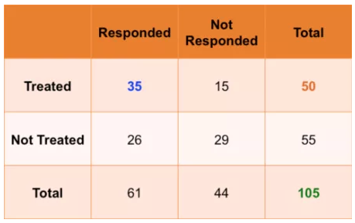
Chi-Square Test in SPSS
The following table shows if their condition improved or not.

Slide 28
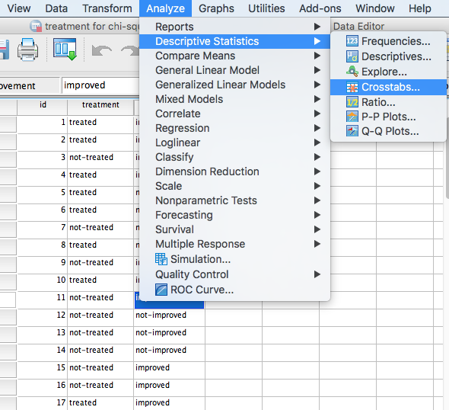
Chi-Square Test in SPSS

Slide 29
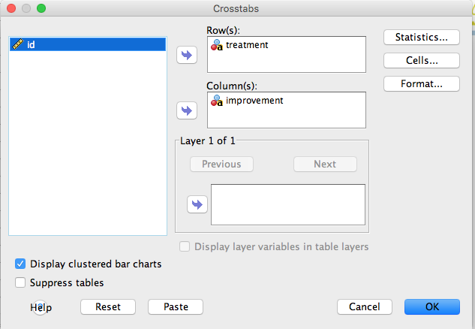
Chi-Square Test in SPSS

Slide 30
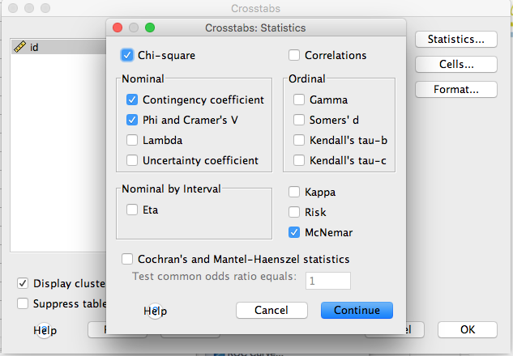
Chi-Square Test in SPSS

Slide 31
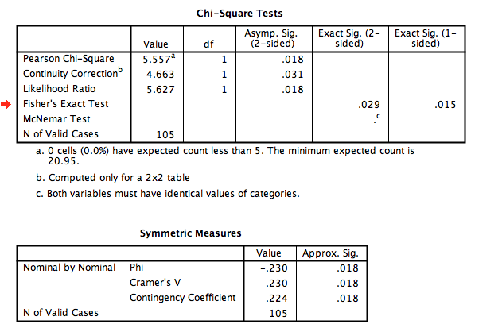
Chi-Square Test in SPSS

Slide 32
APA in Focus: Reporting the Chi-Square Test
To summarize the chi-square goodness-of-fit test, report the test statistic, df, and p value
Observed frequencies can be summarized in a figure or table or in the main text
To summarize the chi-square tests for independence, also report the effect size
Here is a summary of the results for Example 17.2, using Cramer’s V as the measured effect size:
The chi-square test for independence showed a significant relationship between the type of counseling and outcome, , . The data indicate that family involvement in counseling is associated with a greater number of patients completing counseling.

